Slide 1




Secure Digital Asset Management
Protecting Digital Assets with Blockchain-Inspired Auditing and AES Encryption.
Presented By : M Bharath Kumar
Roll No : 23AK1A3607

Slide 2






THE SECURITY GAP
The Problem
The Risk
The Need
Traditional file storage systems lack native end-to-end encryption, leaving data vulnerable.
Server-side breaches and lack of tamper-proof audit trails expose critical file interactions.
A unified vault combining high-security encryption with proactive monitoring.

Slide 3
METHODOLOGY & APPROACH
Architecture: Spring Boot micro-monolith focusing on a "Security First" design pattern.
Encryption: Robust AES-128 bit encryption enforced for every byte of uploaded data.
Integrity: Blockchain-inspired logging; security events are SHA-256 hashed and chained.
Frontend: Glassmorphic UI with Three.js WebGL backgrounds for immersive visuals.
Database: H2 embedded database utilized with encrypted storage pathing.

Slide 4

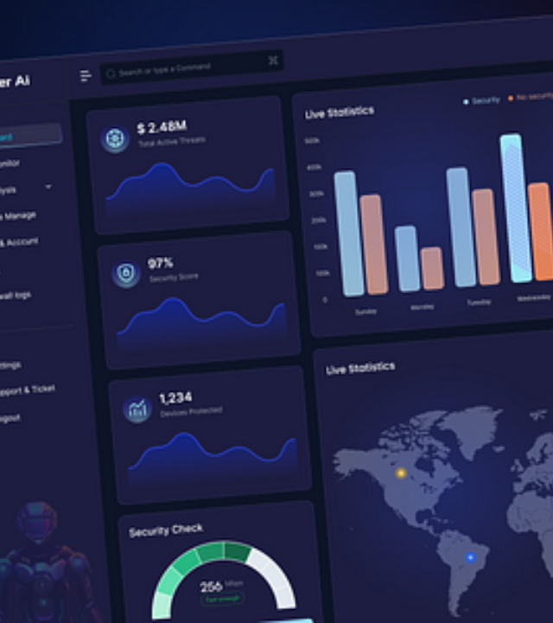
RESULTS & OUTCOMES
RESULTS & OUTCOMES
PROJECT OUTCOME
Successful Deployment: A functional web-based vault for secure asset deposit/withdrawal.
Successful Deployment: A fully functional web-based vault for depositing and withdrawing assets with total privacy.
Successful Deployment: A fully functional web-based vault for depositing and withdrawing assets with total privacy.
Zero-Plaintext Storage: No sensitive files are stored in their original form; everything is encrypted at the byte level.
Zero-Plaintext Storage: No sensitive files are stored in their original form; everything is encrypted at the byte level.
Zero-Plaintext Storage: No sensitive files are stored in original form; byte-level encryption is absolute.
Secure Auditing: Verified tamper-proof logs that can detect if an audit entry has been altered, ensuring accountability.
Secure Auditing: Verified tamper-proof logs that can detect if an audit entry has been altered, ensuring accountability.
Secure Auditing: Verified tamper-proof logs detect any unauthorized audit alterations instantly.
User Engagement: Premium UI/UX that makes high-level security management accessible and visually engaging.
User Engagement: Premium UI/UX that makes high-level security management accessible and visually engaging.
User Engagement: Premium UI/UX that simplifies high-level security management.

Slide 5

CONCLUSION
Project Impact
S.A.M successfully demonstrates that heavy cybersecurity measures can be integrated seamlessly with modern, premium web experiences without compromising performance.
Key Achievements
We met all core objectives: robust byte-level encryption, role-based access control, and forensic blockchain auditing are live on the platform.
Future Roadmap
Expansion to multi-cloud storage clusters and integration of hardware-based MFA (U2F/FIDO2) for physical key authentication.

